Slide 1
SLEEP TRACKING APP FOR BETTER NIGH’S REST
BY
UDHAYAKUMAR.U
814622104053

Slide 2
DESCRIPTION
A sleep tracking app helps monitor and improve your sleep patterns, offering valuable insights to help you achieve a better night's rest. These apps typically use your smartphone’s sensors or integrate with wearable devices to track your sleep cycles, duration, and quality. Features often include:
Sleep Cycle Analysis: Tracks when you're in light, deep, or REM sleep, helping you understand your sleep stages.
Personalized Insights: Offers tailored recommendations based on your sleep data, such as optimal bedtime or tips for improving sleep quality.
Sleep Goals: Helps set and track progress toward sleep goals, such as consistent sleep times or achieving a set amount of restful sleep.
Smart Alarms: Some apps feature a smart alarm that wakes you during a light sleep phase for a gentler, more refreshed awakening.
Sleep Sounds & Relaxation Tools: Many apps include calming sounds or meditation guides to help you fall asleep faster.
Sleep Journals: Tracks external factors like caffeine intake, exercise, or stress levels to help correlate habits with sleep quality.

Slide 3
Main Activity.java:
package com.example.projectone
import android.content.Context
import android.content.Intent
import android.icu.text.SimpleDateFormat
import android.os.Bundle
import androidx.activity.ComponentActivity
import androidx.activity.compose.setContent
import androidx.compose.foundation.Image
import androidx.compose.foundation.layout.*
import androidx.compose.material.Button
import androidx.compose.material.MaterialTheme
import androidx.compose.material.Surface
import androidx.compose.material.Text
import androidx.compose.runtime.*
import androidx.compose.ui.Alignment
import androidx.compose.ui.Modifier
import androidx.compose.ui.draw.alpha
import androidx.compose.ui.layout.ContentScale
import androidx.compose.ui.res.painterResource
import androidx.compose.ui.unit.dp
import androidx.core.content.ContextCompat

Slide 4
import com.example.projectone.ui.theme.ProjectOneTheme
import java.util.*
class MainActivity : ComponentActivity() {
private lateinit var databaseHelper: TimeLogDatabaseHelper
override fun onCreate(savedInstanceState: Bundle?) {
super.onCreate(savedInstanceState)
databaseHelper = TimeLogDatabaseHelper(this)
databaseHelper.deleteAllData()
setContent {
ProjectOneTheme {
// A surface container using the 'background' color from the theme
Surface(
modifier = Modifier.fillMaxSize(),
color = MaterialTheme.colors.background
) {
MyScreen(this,databaseHelper)
}
}
}
}
}
@Composable
fun MyScreen(context: Context, databaseHelper: TimeLogDatabaseHelper) {
var startTime by remember { mutableStateOf(0L) }
var elapsedTime by remember { mutableStateOf(0L) }
var isRunning by remember { mutableStateOf(false) }
val imageModifier = Modifier

Slide 5
Image(
painterResource(id = R.drawable.sleeptracking),
contentScale = ContentScale.FillHeight,
contentDescription = "",
modifier = imageModifier
.alpha(0.3F),
)
Column(
modifier = Modifier.fillMaxSize(),
horizontalAlignment = Alignment.CenterHorizontally,
verticalArrangement = Arrangement.Center
) {
if (!isRunning) {
Button(onClick = {
startTime = System.currentTimeMillis()
isRunning = true
}) {
Text("Start")
//databaseHelper.addTimeLog(startTime)
}
} else {
Button(onClick = {
elapsedTime = System.currentTimeMillis()
isRunning = false
}) {
Text("Stop")
databaseHelper.addTimeLog(elapsedTime,startTime)
}
}

Slide 6
Spacer(modifier = Modifier.height(16.dp))
Text(text = "Elapsed Time: ${formatTime(elapsedTime - startTime)}")
Spacer(modifier = Modifier.height(16.dp))
Button(onClick = { context.startActivity(
Intent(
context,
TrackActivity::class.java
)
) }) {
Text(text = "Track Sleep")
}
}
}
private fun startTrackActivity(context: Context) {
val intent = Intent(context, TrackActivity::class.java)
ContextCompat.startActivity(context, intent, null)
}
fun getCurrentDateTime(): String {
val dateFormat = SimpleDateFormat("yyyy-MM-dd HH:mm:ss", Locale.getDefault())
val currentTime = System.currentTimeMillis()
return dateFormat.format(Date(currentTime))
}

Slide 7
fun formatTime(timeInMillis: Long): String {
val hours = (timeInMillis / (1000 * 60 * 60)) % 24
val minutes = (timeInMillis / (1000 * 60)) % 60
val seconds = (timeInMillis / 1000) % 60
return String.format("%02d:%02d:%02d", hours, minutes, seconds)
}
Activy_main.xml
<?xml version="1.0" encoding="utf-8"?>
<manifest xmlns:android="http://schemas.android.com/apk/res/android"
xmlns:tools="http://schemas.android.com/tools">
<application
android:allowBackup="true"
android:dataExtractionRules="@xml/data_extraction_rules"
android:fullBackupContent="@xml/backup_rules"
android:icon="@mipmap/ic_launcher"
android:label="@string/app_name"
android:supportsRtl="true"
android:theme="@style/Theme.ProjectOne"
tools:targetApi="31">
<activity

Slide 8
android:name=".TrackActivity"
android:exported="false"
android:label="@string/title_activity_track"
android:theme="@style/Theme.ProjectOne" />
<activity
android:name=".MainActivity"
android:exported="false"
android:label="@string/sleeply"
android:theme="@style/Theme.ProjectOne" />
<activity
android:name=".MainActivity2"
android:exported="false"
android:label="RegisterActivity"
android:theme="@style/Theme.ProjectOne" />
<activity
android:name=".LoginActivity"
android:exported="true"
android:label="@string/app_name"
android:theme="@style/Theme.ProjectOne">
<intent-filter>
<action android:name="android.intent.action.MAIN" />
<category android:name="android.intent.category.LAUNCHER" />
</intent-filter>
</activity>
</application>
</manifest>

Slide 9
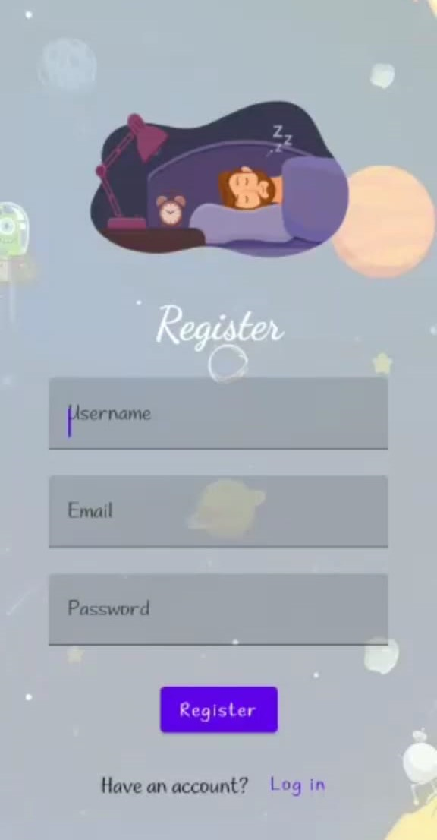
OUTPUT:

Slide 10
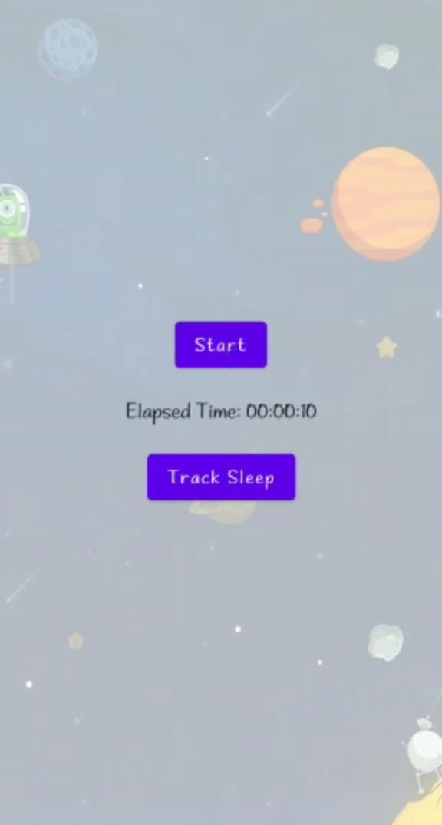

Slide 11
